Slide 1
23CSE373-Computer vision
Image Formation
Geometric Primitives and Transformations

Slide 2
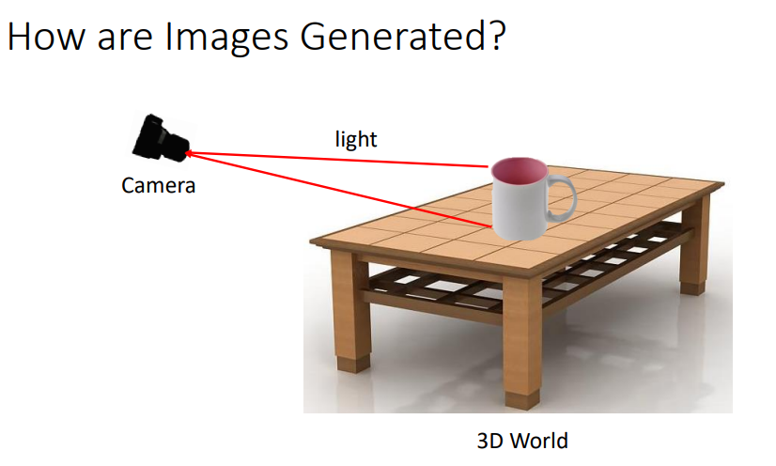

Slide 3
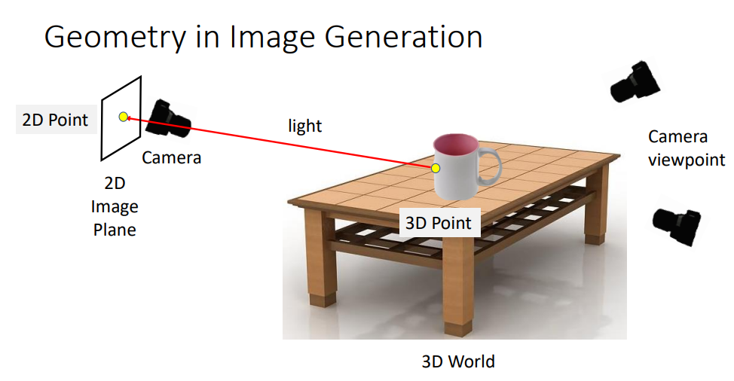

Slide 4


Slide 5
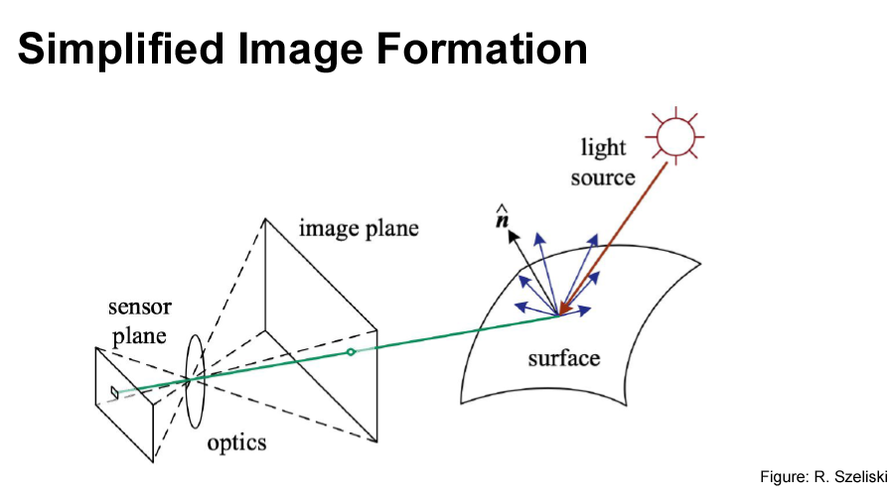

Slide 6
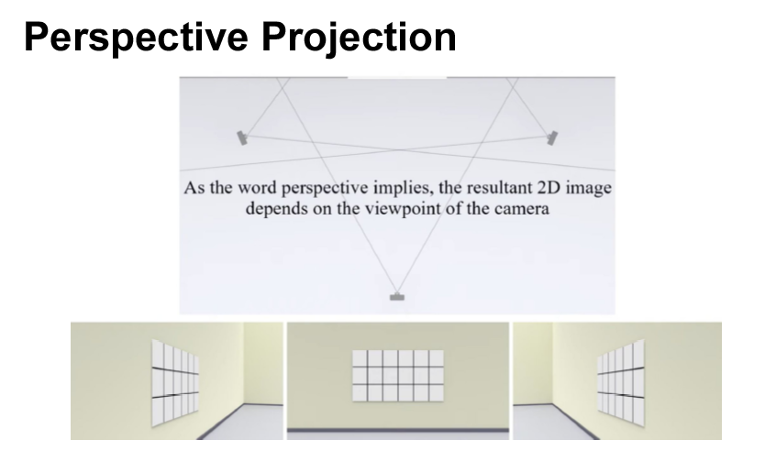

Slide 7
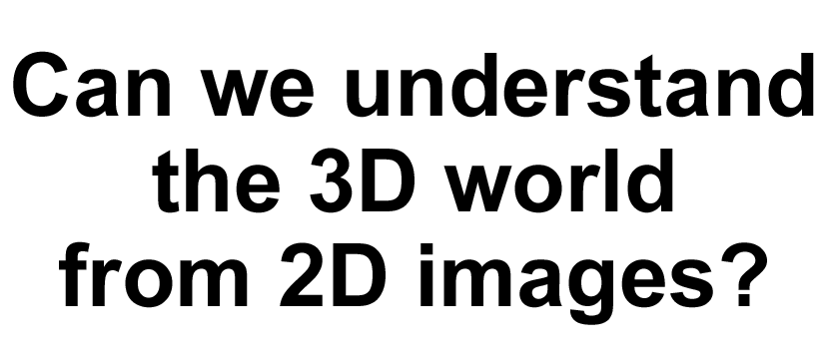

Slide 8
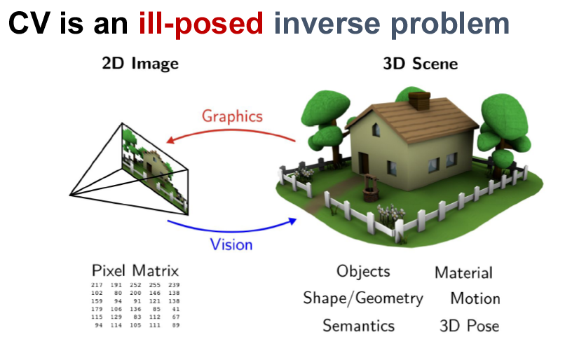

Slide 9
GEOMETRIC PRIMITIVES IN 2D &3D

Slide 10
2D & 3D TRANSFORMATIONS

Slide 11
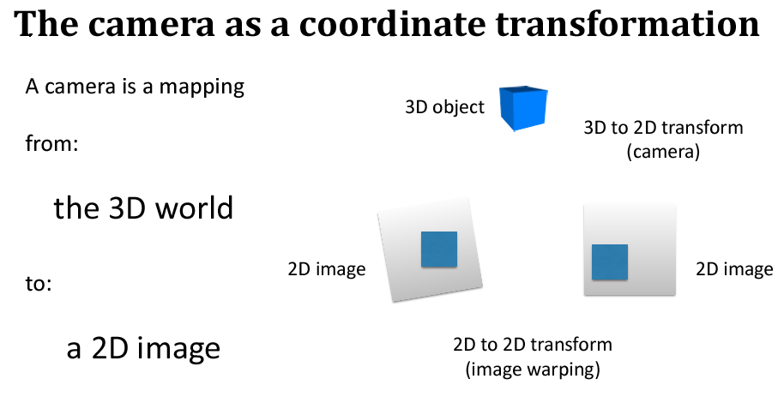

Slide 12
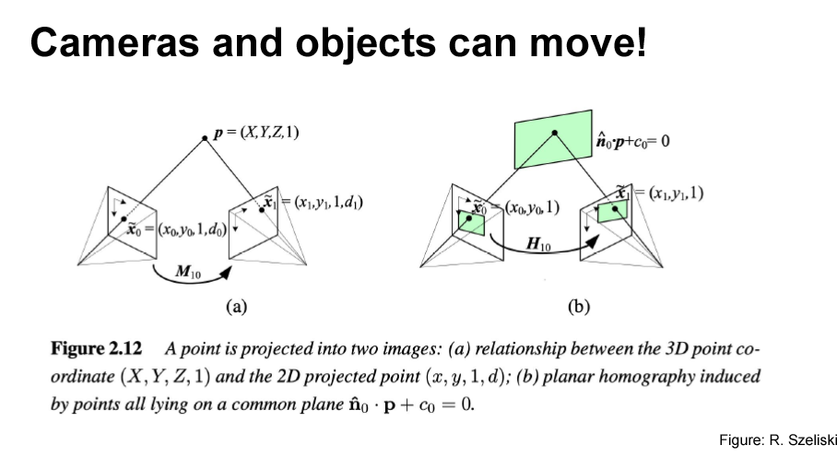

Slide 13
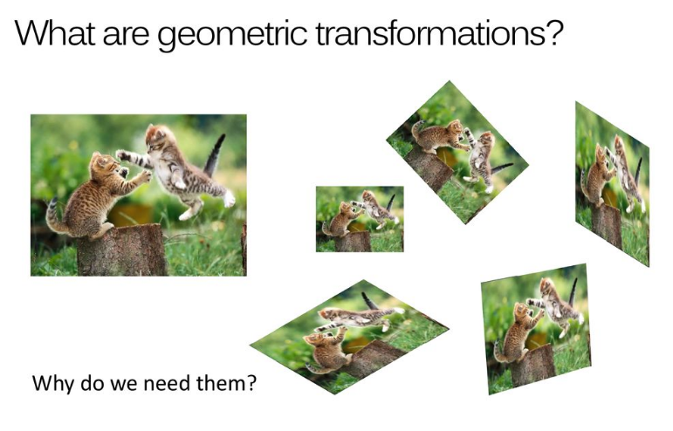

Slide 14
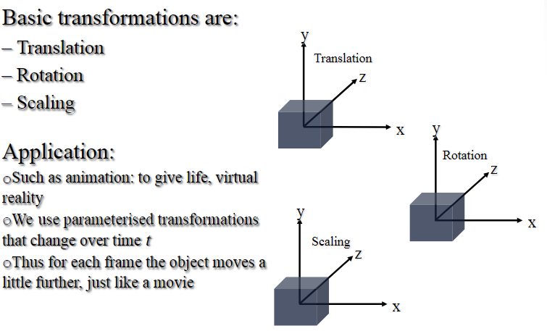

Slide 15
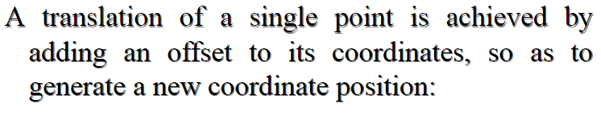
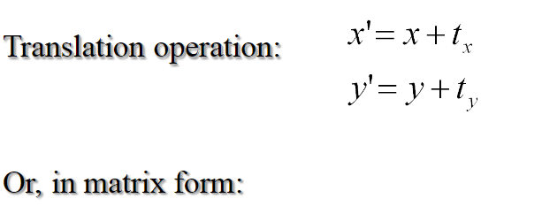
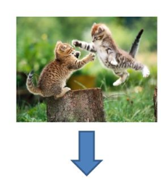

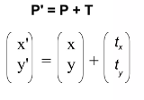
2D Translation

Slide 16
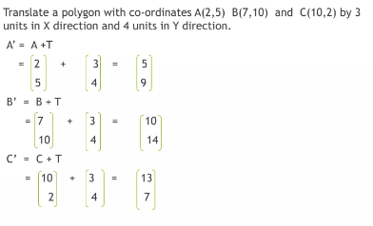
2D Translation

Slide 17
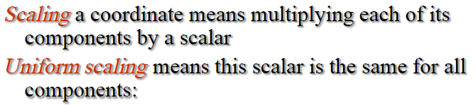

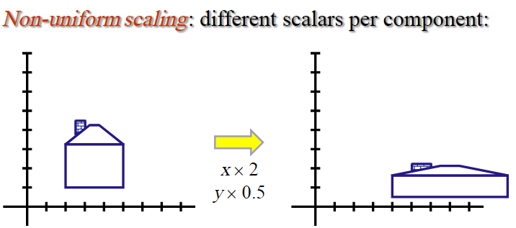
2D Scaling

Slide 18
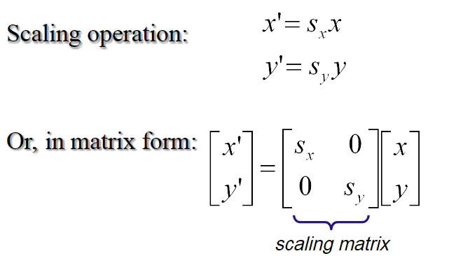
2D Scaling

Slide 19
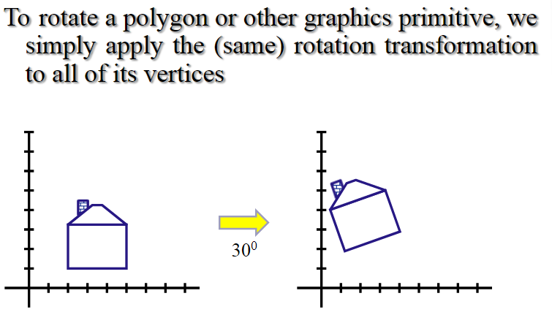
2D Rotation

Slide 20
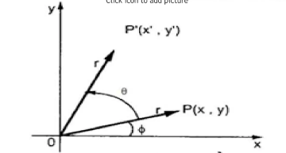
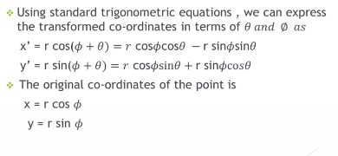
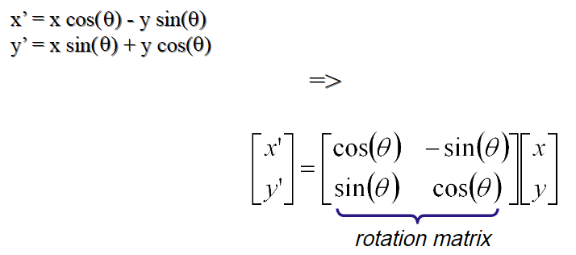
2D Rotation

Slide 21
2D Rotation
Rotate the triangle (0,0),B(1,0),C(1,1) by an angle of 90 degrees in clockwise direction.
Answer:
A’=[0,0]
B’=[0,-1]
C’=[1,-1]

Slide 22
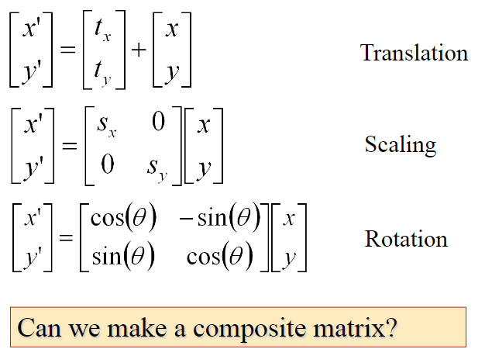
2D Transformation

Slide 23
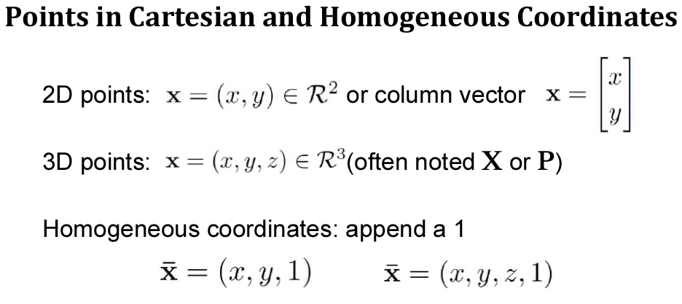

Slide 24
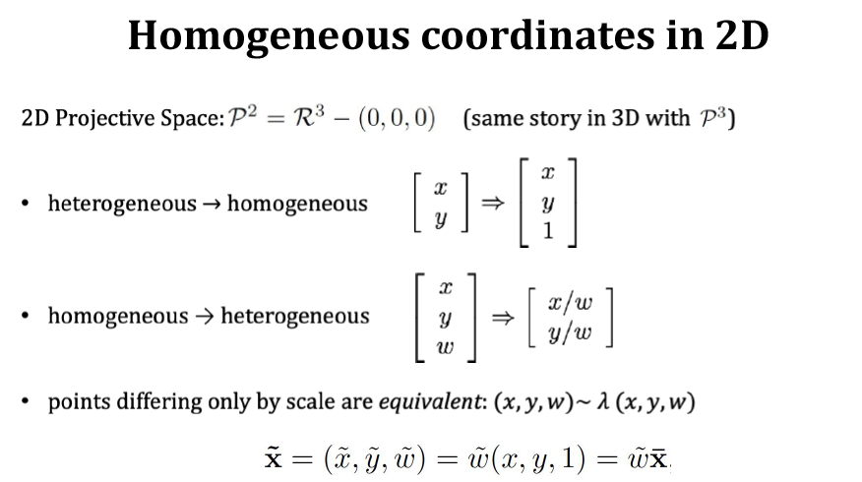

Slide 25
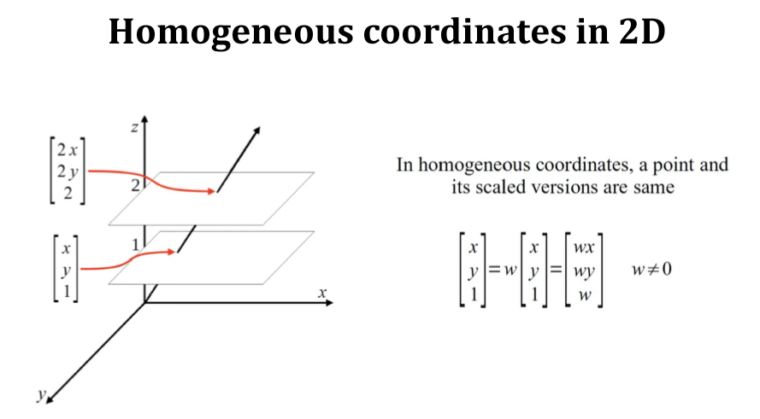

Slide 26

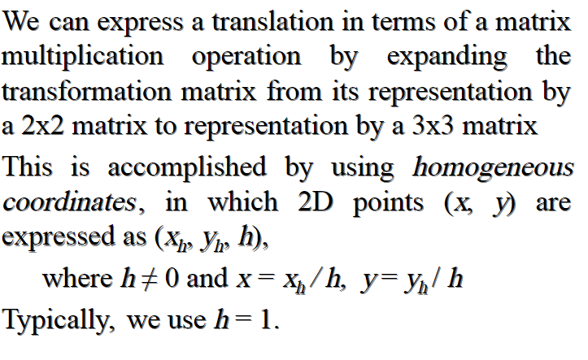

Slide 27
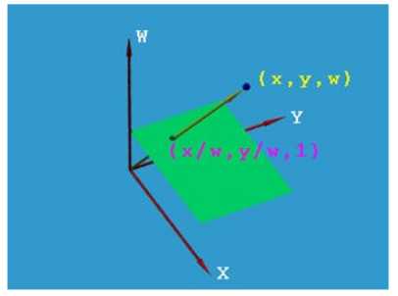
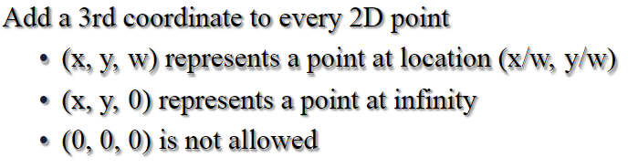
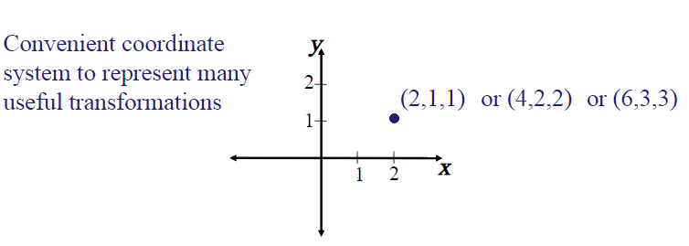

Slide 28

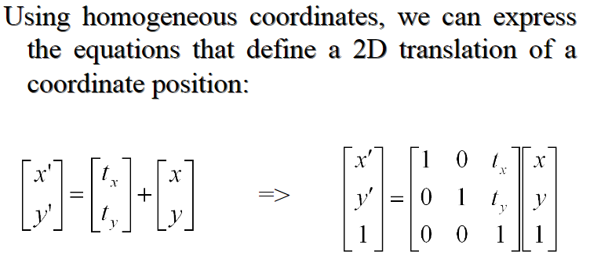

Slide 29

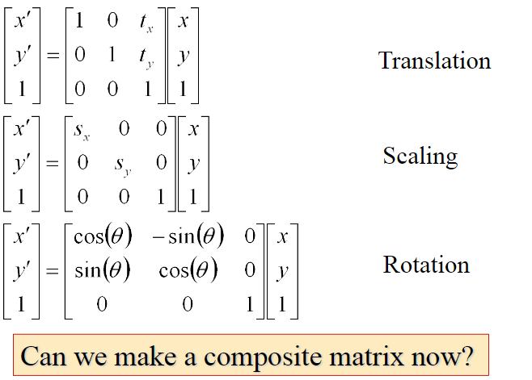

Slide 30

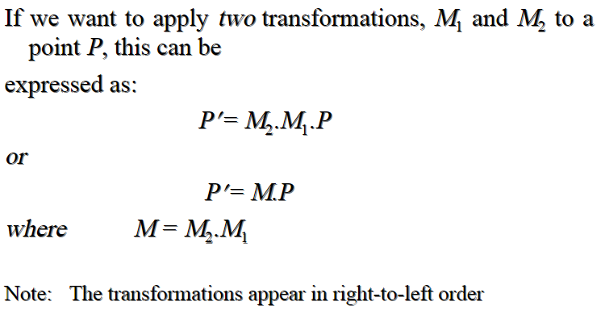

Slide 31
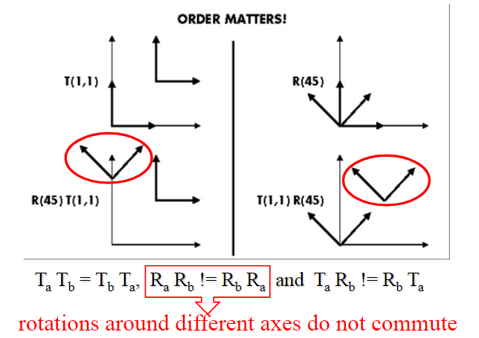

Slide 32
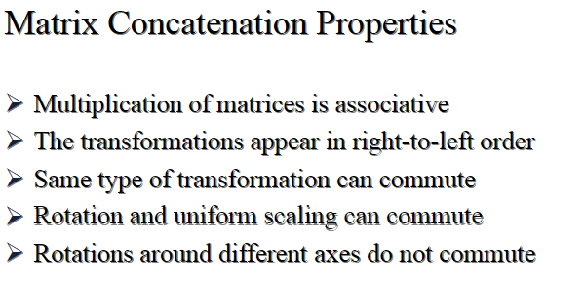

Slide 33
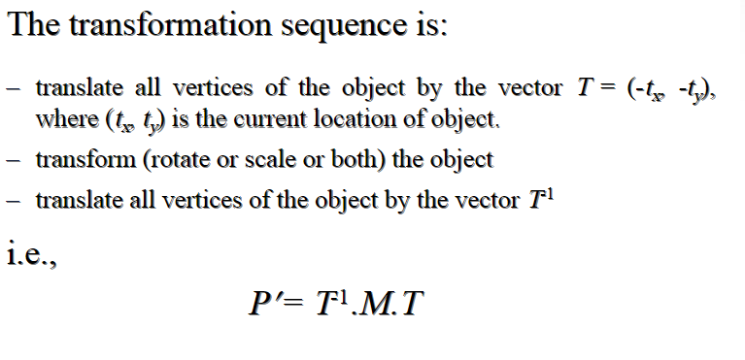

Slide 34
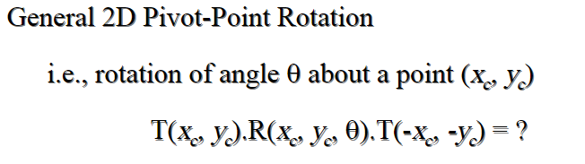
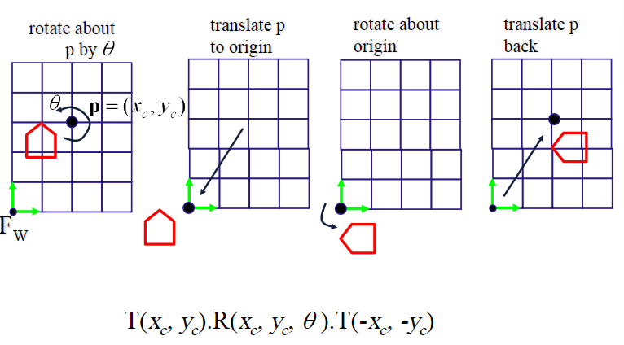
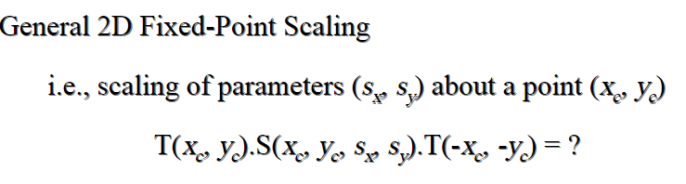

Slide 35
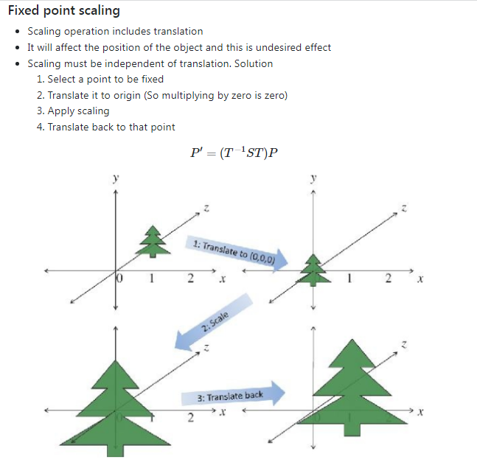

Slide 36
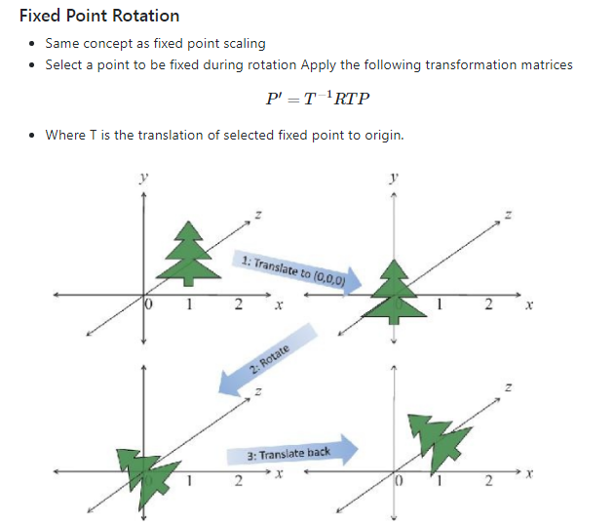

Slide 37
Problem
Perform a scaling transformation that reduces the size to half for the square with vertices at (1,1), (3,1), (3,3), and (1,3), with scaling done about the fixed point (1,1). Show the steps involved.
ANSWER
The new scaled square has vertices:
A' = (1,1)
B' = (2,1)
C' = (2,2)
D' = (1,2)

Slide 38
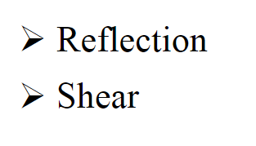

Slide 39

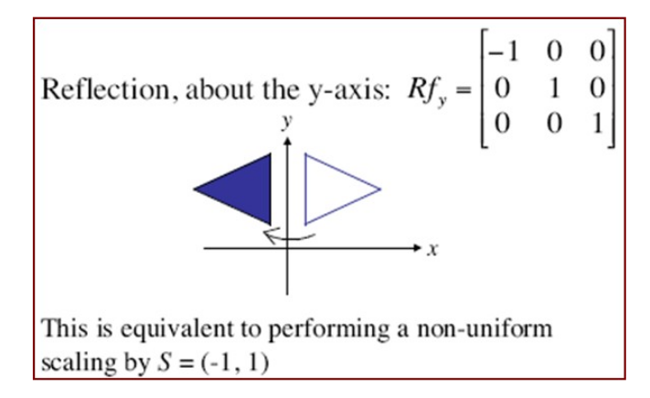
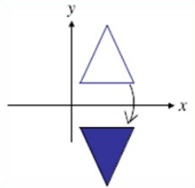
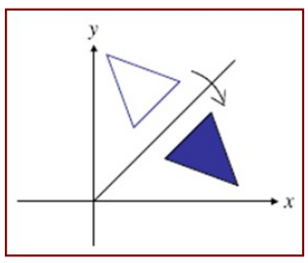

Slide 40

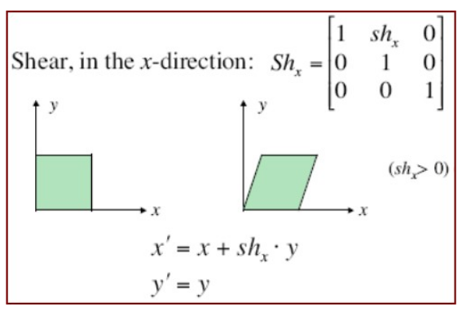
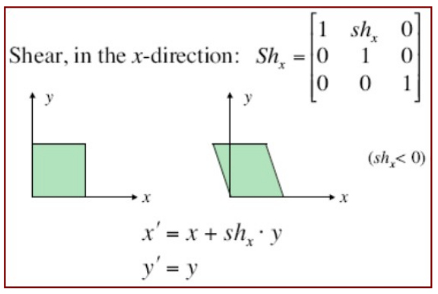

Slide 41
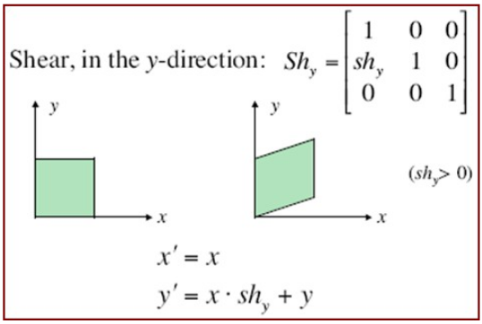
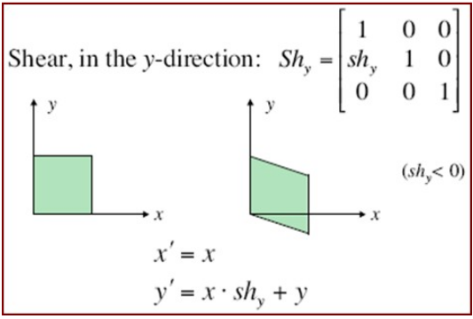

Slide 42
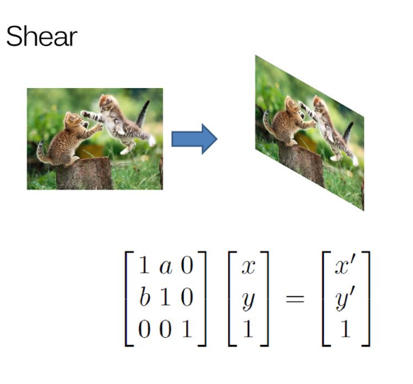

Slide 43
Transform the polygon A(0,0),B(0,1), C(1,0),D(1,1) with a shearing factor of 0.5 w.r.t X axis
Answer:
A’=[0 0 1]
B’=[0.5 1 1 ]
C’=[1 0 1]
D’=[1.5 1 1]

Slide 44


Slide 45

3D Geometric Translation
Translation is defined as the displacement of any object by a given distance and direction from its original position

Slide 46

3D Geometric Translation
To translate a point in three dimensions by tx, ty and tz simply calculate the new points as follows:
x’ = x + tx y’ = y + ty z’ = z + tz
(x, y, z)
(x’, y’, z’)
Translated Position

Slide 47
3D Geometric Translation
The translation of a point P(x,y,z) by (t_{x}, t_{y}, t_{z}) can be written in matrix form as:

Slide 48

3D Geometric Scaling
Scaling is the process of expanding or compressing the dimensions of an object determined by the scaling factor.

Slide 49
3D Geometric Scaling
To scale a point in three dimensions by s_{x}, s_{y} and s_{z} simply calculate the new points as follows:
x’ = s_{x}*x y’ = s_{y}*y z’ = s_{z}*z
(x, y, z)
(x’, y’, z’)
Scaled Position

Slide 50
3D Geometric Scaling
The scaling of a point P(x , y , z) by scaling factors S_{x}, S_{y} and S_{z} about origin can be written in matrix form as:

Slide 51

3D Geometric Rotations
When we performed rotations in two dimensions we only had the choice of rotating about the z axis
In the case of three dimensions we have more options
Rotate about x
Rotate about y
Rotate about z

Slide 52

3D Geometric Rotations
The equations for the three kinds of rotations in 3-D are
x’ = x·cosθ - y·sinθ
y’ = x·sinθ + y·cosθ
z’ = z
x’ = x
y’ = y·cosθ - z·sinθ
z’ = y·sinθ + z·cosθ
x’ = z·sinθ + x·cosθ
y’ = y
z’ = z·cosθ - x·sinθ

Slide 53


Slide 54
Exercise
Rotate the triangle with vertices A(0, 2, 1), B(2, 3, 0), and C(1, 2, 1) by 90° around the Y-axis. Provide the new coordinates of the rotated triangle.

Slide 55


Slide 56



Slide 57


Slide 58



Slide 59


Slide 60


Slide 61



Slide 62


Slide 63
Projective Transformation
When the viewpoint of the observer (camera location) changes, the perceived object also changes. This effect is modeled with a projective transformation.
A projective transformation or homography is a non-linear transformation that maps image points between two camera views, under the assumption that they belong to a planar scene.
The projective transformation preserves collinearity, but does not preserve parallelism, lengths, and angles of lines. It shows the change in the perceived object.

Slide 64

Two types of projection

Slide 65


Parallel and Perspective Projection

Slide 66



Parallel Projection
Projection vector: Defines the direction for the projection lines (projectors).
Orthographic Projection: Projectors (projection vectors) are perpendicular to the projection plane.
Oblique Projection: Projectors (projection vectors) are not perpendicular to the projection plane.

Slide 67


Orthographic Parallel Projection
Orthographic projection used to produce the front, side, and top views of an object.

Slide 68

Orthographic Parallel Projection
Front, side, and rear orthographic projections of an object are called elevations.
Top orthographic projection is called a plan view.

Slide 69

Orthographic Parallel Projection Transformation
Since the view plane is placed at position z_{vp} along the z_{v} axis. Then any point (x,y,z) in viewing coordinates is transformed to projection coordinates as:

Slide 70

Perspective Projection
In a perspective projection, the center of projection is at a finite distance from the viewing plane.
Produces realistic views but does not preserve relative proportion of objects
The size of a projection object is inversely proportional to its distance from the viewing plane.

Slide 71

Perspective Projection
Parallel lines that are not parallel to the viewing plane, converge to a vanishing point.
A vanishing point is the projection of a point at infinity.

Slide 72

Perspective Projection

Slide 73

Perspective Projection

Slide 74




Slide 75

Perspective Projection

Slide 76

Perspective Projection

Slide 77

Perspective Projection

Slide 78

Perspective Projection

Slide 80

Perspective Projection

Slide 81

Perspective Projection

Slide 82

Perspective Projection

Slide 83

Perspective Projection

Slide 84

Perspective Projection

Slide 85


Slide 86



Slide 87


Convex Quadrilateral

Slide 88

Projective Transformation

Slide 89

Projective Transformation

Slide 90

Projective Transformation

Slide 91

Projective Transformation

Slide 92

Projective Transformation

Slide 93

Projective Transformation

Slide 94

Projective Transformation

Slide 95

Projective Transformation

Slide 96

Projective Transformation

Slide 97

Projective Transformation

Slide 98

Projective Transformation

Slide 99

Projective Transformation

Slide 100

Projective Transformation

Slide 101

Projective Transformation

Slide 102

Projective Transformation

Slide 103

Projective Transformation

Slide 104

Projective Transformation

Slide 105

Projective Transformation

Slide 106

Projective Transformation

Slide 107

Projective Transformation

Slide 108

Projective Transformation

Slide 109

Projective Transformation

Slide 110

Projective Transformation

Slide 111



Projective Transformation

Slide 112

Projective Transformation

Slide 113
Reference
https://www.youtube.com/watch?v=2BIzmFD_pRQ&t=32s
Refer this video for the contents in this PPT regarding projective transformation.

Slide 114


Slide 115



Slide 116


Slide 117
THANK YOU

